Slide 1


Comparative Study on Gold SIP & Gold ETF.
Analyzing Investment Strategies, Costs, and Returns in Paper Gold.

Slide 2

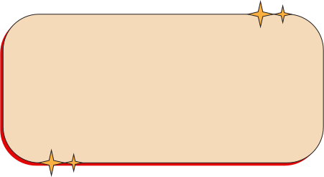


TEAM MEMBER
Palak Basotia
Megh Patel
Gritika Kothari
Mayank Pravin Tulaskar

Slide 3

Investment refers to allocating money with the expectation of generating future returns.
Gold has been considered a reliable and traditional form of investment for centuries.
With financial innovation, modern options like Gold SIP and Gold ETFs have gained popularity.
This project focuses on comparing these two investment methods.
INTRODUCTION

Slide 4

GOLD SIP CONCEPT
MEANING
Gold SIP (Systematic Investment Plan) allows investors to invest small amounts regularly in gold.
It is usually offered through mutual funds or digital platforms.
Suitable for investors who prefer disciplined and gradual investment.

Slide 5

FEATURE OF GOLD SIP
Fixed periodic investment (monthly/weekly)
Rupee Cost Averaging benefit
Low initial investment requirement
Easy and automated investment process
No need for market timing

Slide 6

ADVANTAGES & DISADVANTAGES OF
GOLD SIP
ADVANTAGES:
Affordable for small investors
Reduces market risk through averaging
Encourages disciplined saving
DISADVANTAGES:
Returns may be lower compared to ETFs
Management and platform charges may apply

Slide 7

GOLD ETF CONCEPT
MEANING:-
Gold ETF (Exchange Traded Fund) is traded on stock exchanges like shares.
It represents physical gold in electronic form.
Requires a Demat and trading account.

Slide 8

FEATURES OF GOLD ETF
Traded in real-time on stock exchanges
High liquidity and transparency
No storage or security concerns
Tracks gold market prices closely

Slide 9

ADVANTAGES:
High liquidity and flexibility
Lower long-term cost
Safe and regulated investment
DISADVANTAGES:
Requires Demat account
Requires basic market knowledge
ADVANTAGES & DISADVANTAGES
OF GOLD ETF

Slide 10
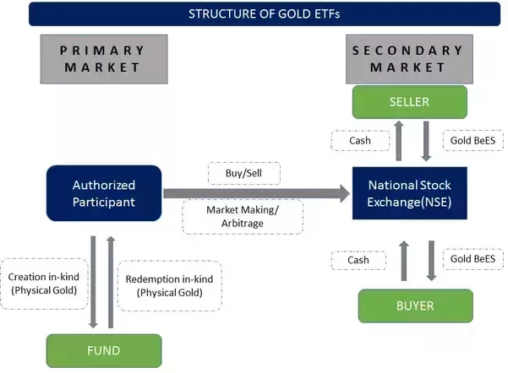
WORKING PROCESS
GOLD SIP:
Investor contributes a fixed amount regularly
Units are allocated based on current gold prices
GOLD ETF:
Investors buy/sell units through stock exchange
Prices fluctuate based on market demand and gold rates

Slide 11
COMPARATIVE ANALYSIS
Basis | Gold SIP | Gold ETF
Investment Style | Periodic | Market-based
Risk Level | Moderate | Low
Liquidity | Medium | High
Demat Account | Not Required | Required
Flexibility | High | High
Cost | Higher (charges) | Lower

Slide 12
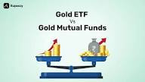
FINDINGS, SUGGESTIONS & CONCLUSION
FINDINGS:
Both options are secure and gold-backed investments
Gold SIP is better for beginners
Gold ETF is more suitable for experienced investors
SUGGESTIONS:
Choose Gold SIP for regular and disciplined investing
Choose Gold ETF for higher flexibility and liquidity
CONCLUSION:
The choice between Gold SIP and Gold ETF depends on the investor’s financial goals, risk appetite, and market knowledge

Slide 13

Financial Websites (e.g., RBI, NSE)
Investment Articles and Journals
Books on Financial Management
Online Research Sources
BIBLIOGRAPHY

Slide 14
THANK YOU.

